Slide 1

Multiple features
Linear Regression with multiple variables
Machine Learning
Presented by : ilyas tammouch

Slide 2


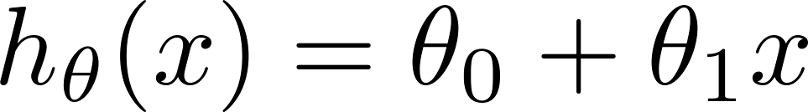
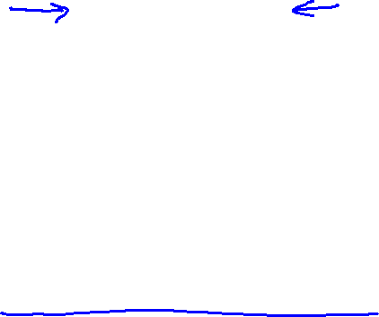
Multiple features (variables).
Size (feet²) | Price ($1000)
2104 | 460
1416 | 232
1534 | 315
852 | 178
… | …

Slide 3
Multiple features (variables).
Size (feet²) | Number of bedrooms | Number of floors | Age of home (years) | Price ($1000)
2104 | 5 | 1 | 45 | 460
1416 | 3 | 2 | 40 | 232
1534 | 3 | 2 | 30 | 315
852 | 2 | 1 | 36 | 178
… | … | … | … | …

Slide 4



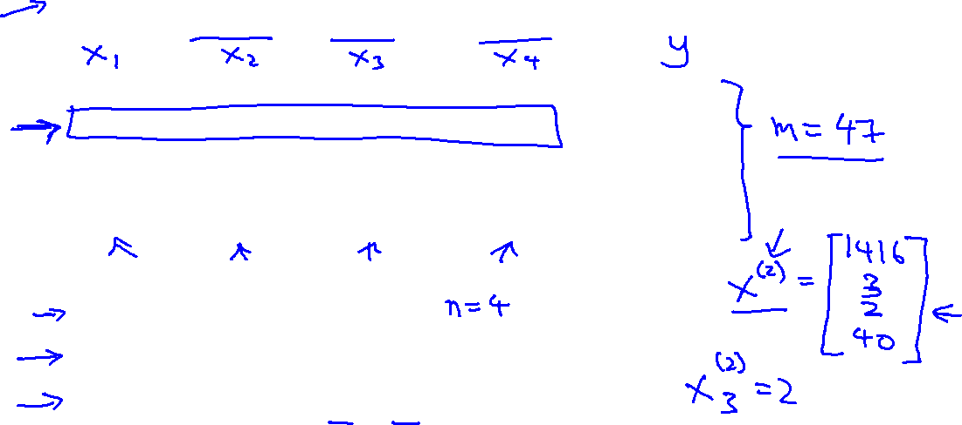
Multiple features (variables).
Size (feet²) | Number of bedrooms | Number of floors | Age of home (years) | Price ($1000)
2104 | 5 | 1 | 45 | 460
1416 | 3 | 2 | 40 | 232
1534 | 3 | 2 | 30 | 315
852 | 2 | 1 | 36 | 178
… | … | … | … | …
Notation:
= number of features
= input (features) of training example.
= value of feature in training example.
Notes:
Pop-up Quiz

Slide 5
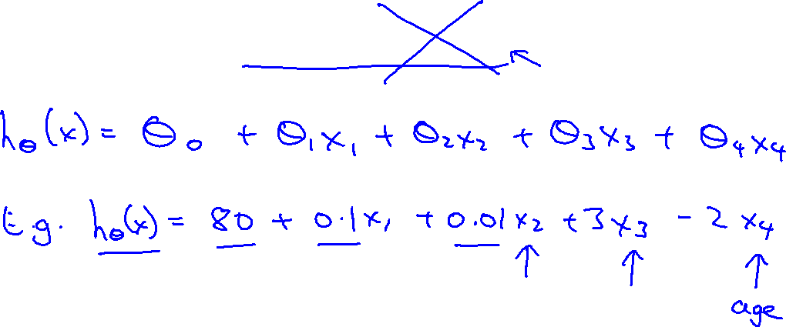
Hypothesis:
Previously:

Slide 6
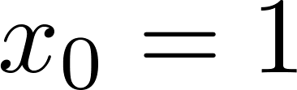
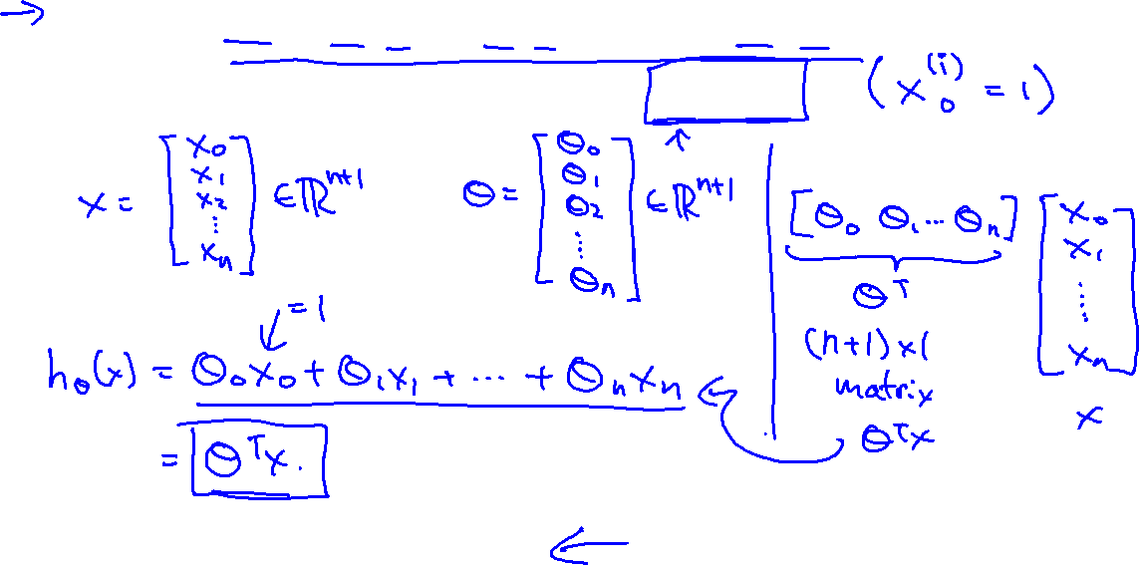
For convenience of notation, define .
Multivariate linear regression.

Slide 7
Gradient descent for multiple variables
Linear Regression with multiple variables
Machine Learning

Slide 8
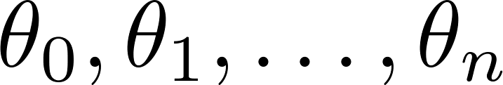
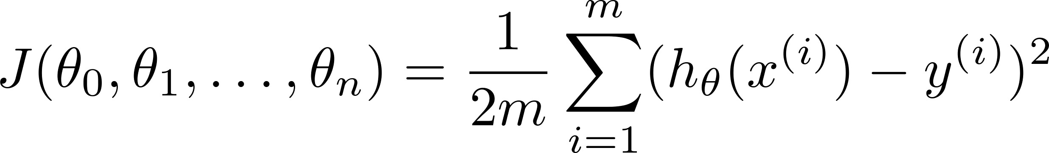

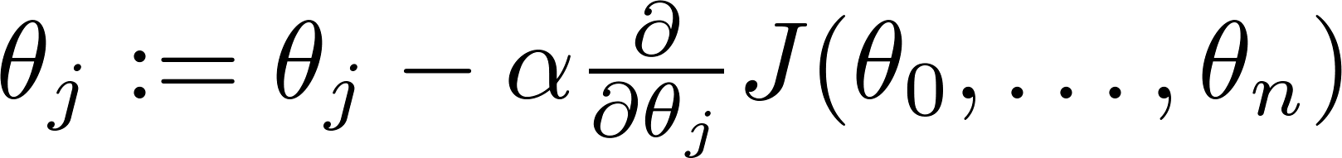

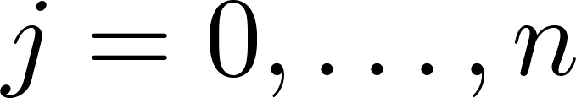
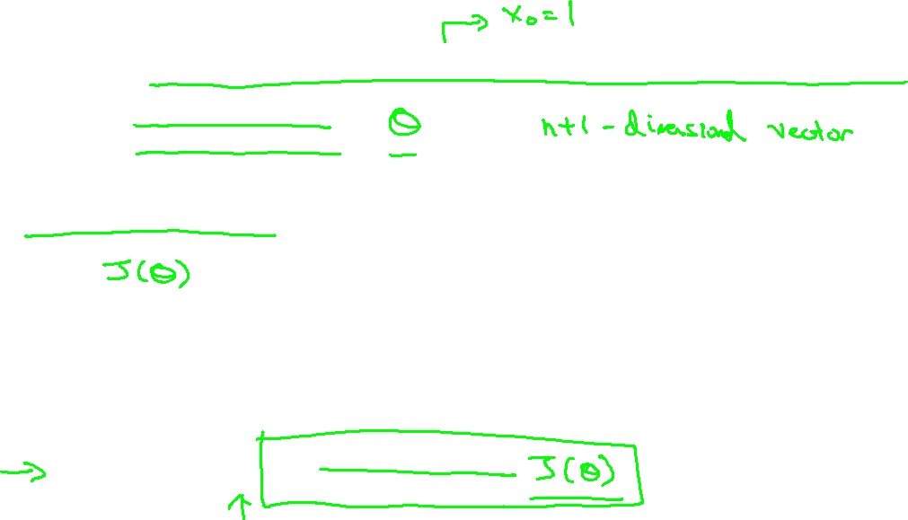
Hypothesis:
Parameters:
Cost function:
Gradient descent:
Repeat
(simultaneously update for every )

Slide 9

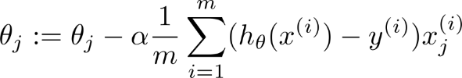
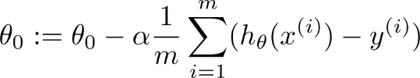


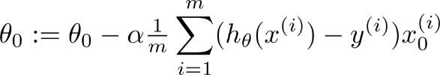
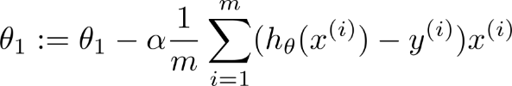
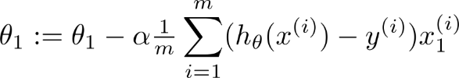

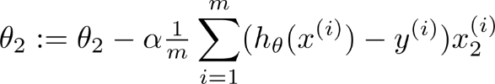
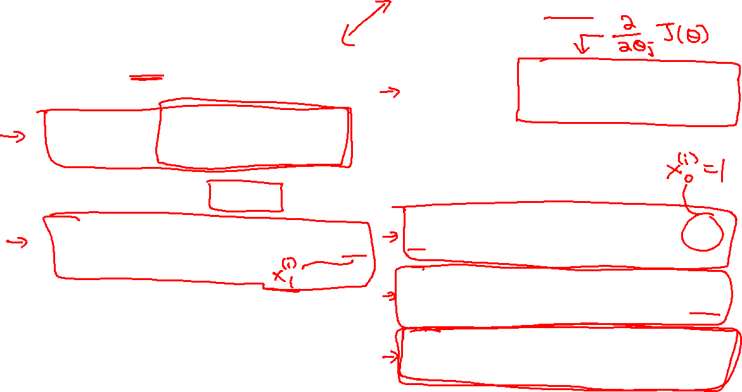
New algorithm :
Gradient Descent
Repeat
Previously (n=1):
Repeat
(simultaneously update for
)
(simultaneously update )

Slide 10
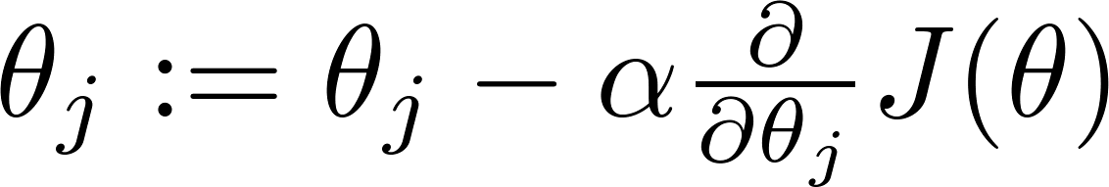

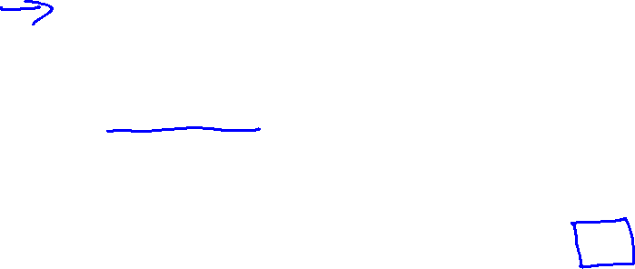
Gradient descent
“Debugging”: How to make sure gradient descent is working correctly.
How to choose learning rate .

Slide 11
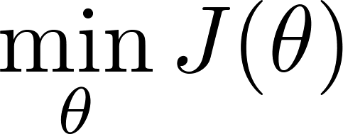
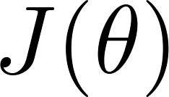
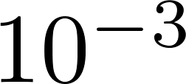
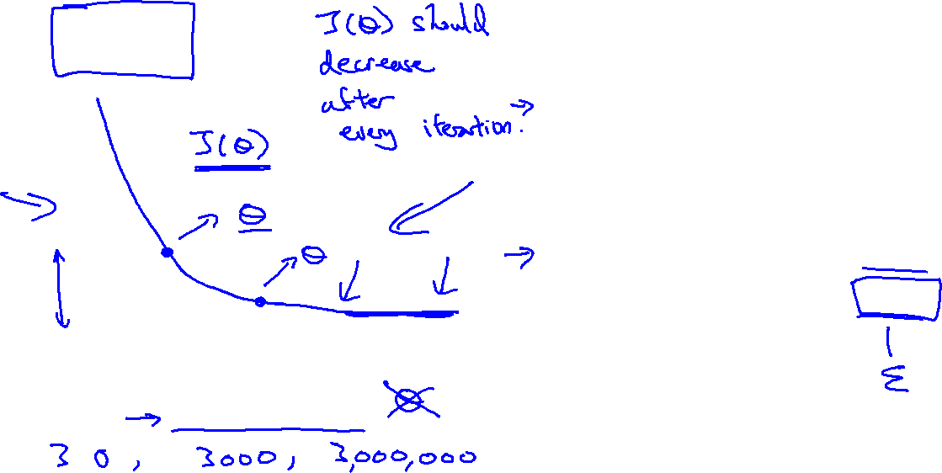
Making sure gradient descent is working correctly.
Example automatic convergence test:
Declare convergence if decreases by less than in one iteration.
No. of iterations

Slide 12

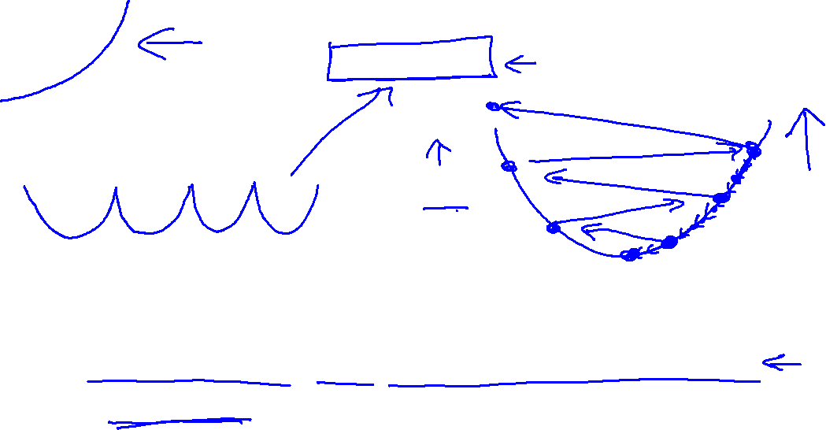
Making sure gradient descent is working correctly.
Gradient descent not working.
Use smaller .
No. of iterations
No. of iterations
No. of iterations
For sufficiently small , should decrease on every iteration.
But if is too small, gradient descent can be slow to converge.

Slide 13
Summary:
If is too small: slow convergence.
If is too large: may not decrease on every iteration; may not converge.
To choose , try

Slide 14
Features and polynomial regression
Linear Regression with multiple variables
Machine Learning

Slide 15
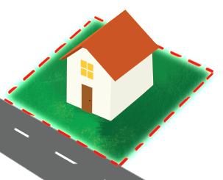
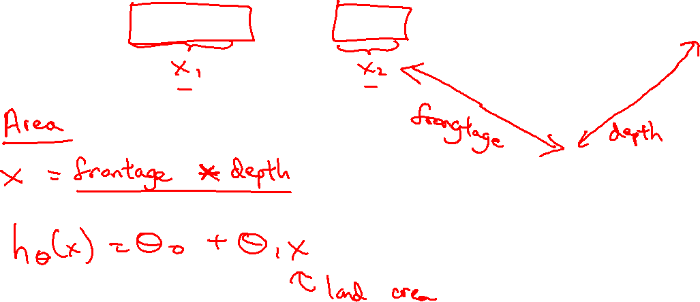
Housing prices prediction

Slide 16
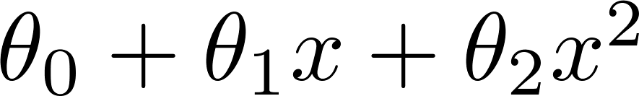
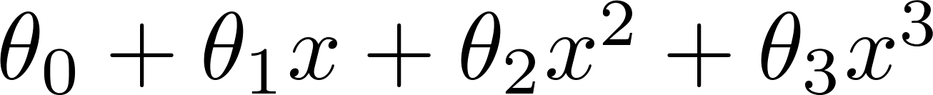
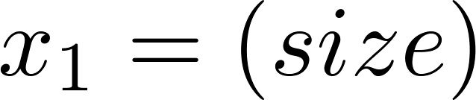
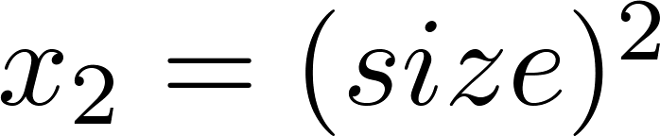
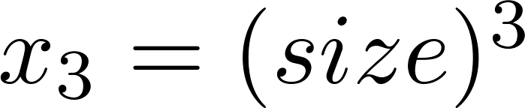
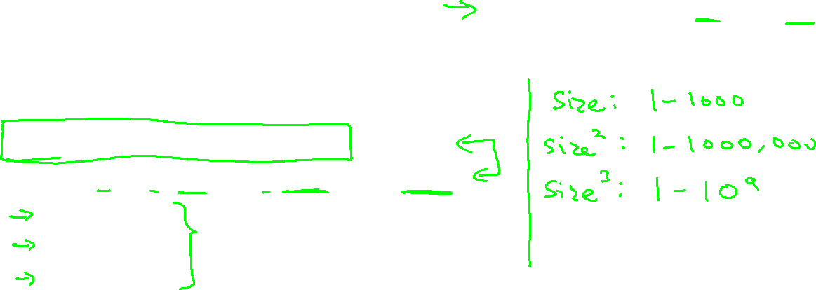
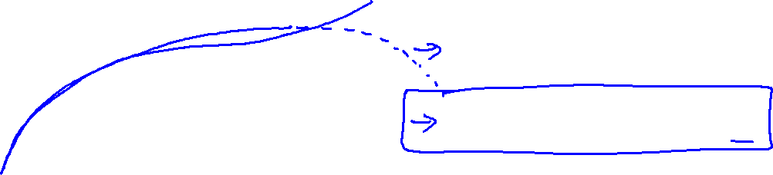
Polynomial regression
Price
(y)
Size (x)

Slide 17
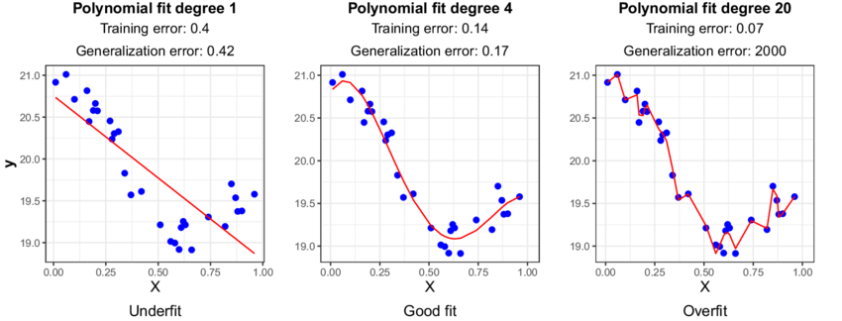
Underfitting: Poor performance on the training data and poor generalization to other data.
Overfitting: Good performance on the training data, poor generliazation to other data.

Slide 18
Normal equation
Linear Regression with multiple variables
Machine Learning

Slide 19

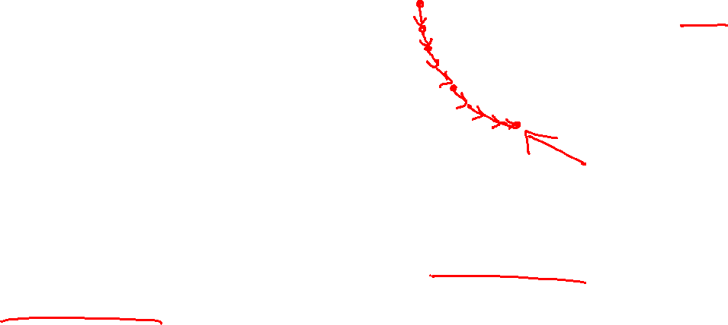
Gradient Descent
Normal equation: Method to solve for
analytically.

Slide 20





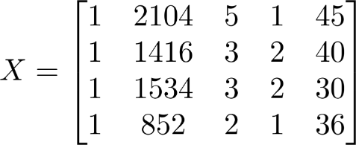
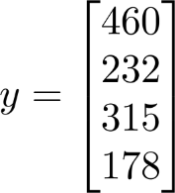
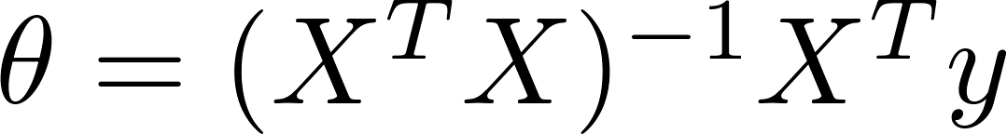
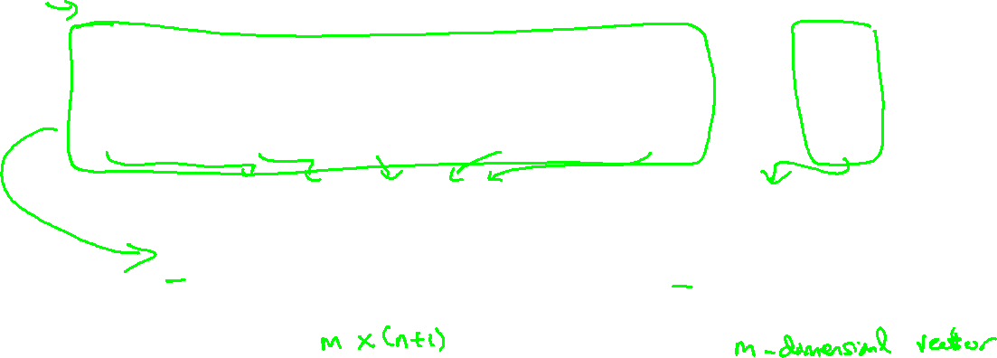
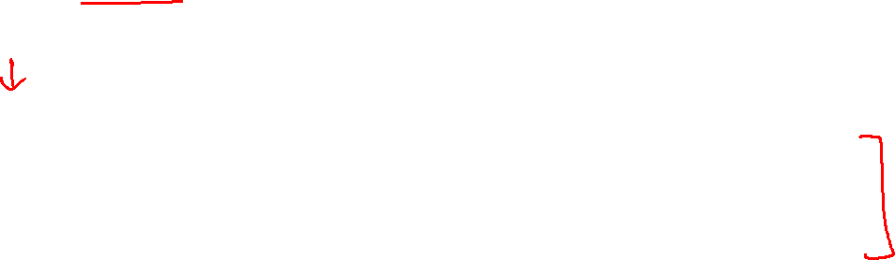

Examples:
 | Size (feet²) | Number of bedrooms | Number of floors | Age of home (years) | Price ($1000)
1 | 2104 | 5 | 1 | 45 | 460
1 | 1416 | 3 | 2 | 40 | 232
1 | 1534 | 3 | 2 | 30 | 315
1 | 852 | 2 | 1 | 36 | 178
Size (feet²) | Number of bedrooms | Number of floors | Age of home (years) | Price ($1000)
2104 | 5 | 1 | 45 | 460
1416 | 3 | 2 | 40 | 232
1534 | 3 | 2 | 30 | 315
852 | 2 | 1 | 36 | 178
Notes:
Pop-up Quiz

Slide 21


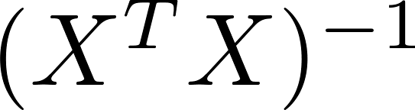
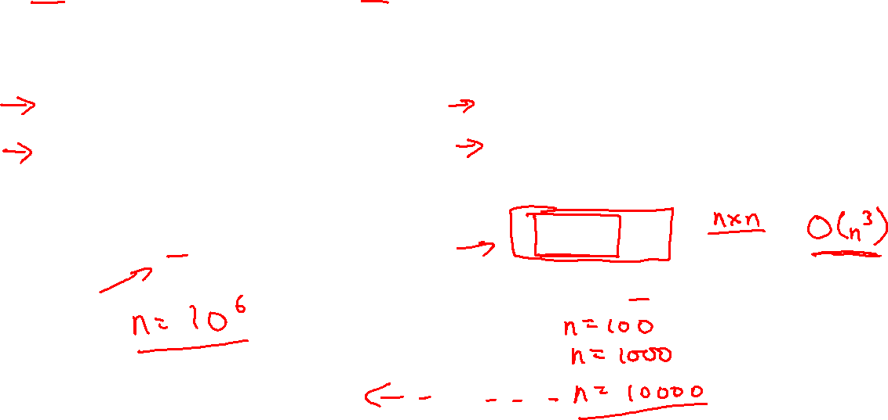
training examples, features.
Gradient Descent
Normal Equation
Need to choose .
Needs many iterations.
No need to choose .
Don’t need to iterate.
Works well even when is large.
Need to compute
Slow if is very large.

Slide 22
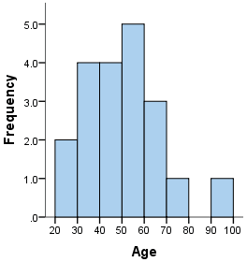
Describing Data Graphically
Histograms – An histogram is a graph used to represent the frequency distribution of a few data points of one variable. Histograms often classify data into various “bins” or “range groups” and count how many data points belong to each of those bins..
Notes:
La frequence d’une distribution

Slide 23
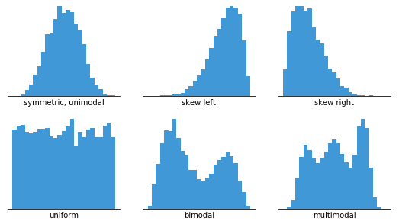
Notes:
a probability distribution that is symmetric about the mean, showing that data near the mean are more frequent in occurrence than data far from the mean

Slide 24
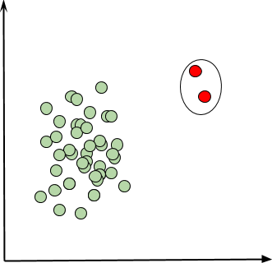
Checking for Outliers
An outlier is data point that is extremely far away from the rest of the data and may effect some of the measurements we take from that data.

Slide 25
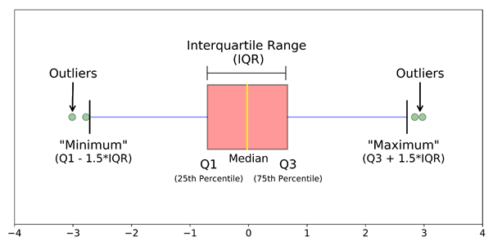
Boxplots
A boxplot is a standardized way of displaying the distribution of data based on a five number summary (“minimum”, first quartile [Q1], median, third quartile [Q3] and “maximum”). It can tell you about your outliers and what their values are.

Slide 26
Find the minimum, maximum, median (Q2), lower quartile (Q1), and upper quartile (Q3) for the following sets of data and draw the Box and Whisker plot (or Boxplot)
6, 1, 7, 6, 5, 5, 0, 1, 0, 8, 4

Slide 27
Center
For describing the center of the data, we can use either the Median or the Mean.
Both are useful, in cases where the data is skewed one way the Median is a better choice because it is more resistant to outliers.

Slide 28
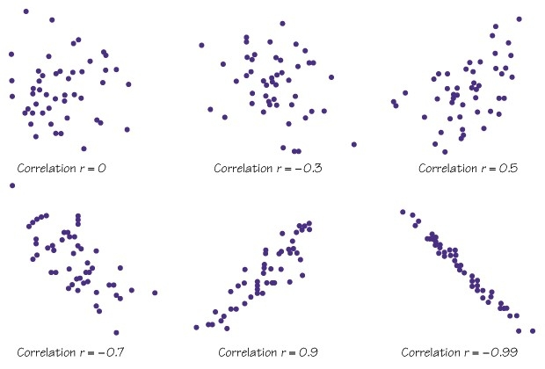
Correlation, r
The correlation, r, measures the direction and strength of the linear relationship between two quantitative variables.
These values fall between -1 and 1, inclusive.
R < 0, tells us a negative association between the variables
R > 0, tells us a positive association between the variables
R - 0, tells us there is a very weak linear relationship
The closer the values are to 1 or -1, the stronger the linear relationship between the variables.
When the points form an exact straight line the r values are either -1 or 1, this very rarely (almost never) happens in real world observations.

